Slide 1
ASP.NET MVC
Asp.net MVC Overview
Benefits of ASP.NET MVC
ASP.NET MVC – Pattern
ASP.NET MVC - Life Cycle
ASP.NET MVC – Routing, Attribute routing, Custom Routing, Route Constraints
Types of Action
Action Selector
ASP.NET MVC - Model Binding, Value Provider, Model Binder
Session Handling in ASP.NET MVC 5
Viewbag, ViewData and TempData

Slide 2
ASP.NET MVC OVERVIEW:
ASP.NET MVC is basically a web development framework from Microsoft, which combines the features of MVC (Model-View-Controller) architecture, the most up-to-date ideas and techniques from Agile development, and the best parts of the existing ASP.NET platform.
ASP.NET MVC is not something, which is built from ground zero. It is a complete alternative to traditional ASP.NET Web Forms.
ASP.NET MVC was announced in 2007, the MVC pattern was becoming one of the most popular ways of building web frameworks.
In April 2009, the ASP.NET MVC source code was released under the Microsoft Public License (MS-PL). "ASP.NET MVC framework is a lightweight, highly testable presentation framework that is integrated with the existing ASP.NET features.
Some of these integrated features are master pages and membership-based authentication. The MVC framework is defined in the System.Web.Mvc assembly.

Slide 3
Benefits of ASP.NET MVC
Following are the benefits of using ASP.NET MVC −
It makes easier to manage complexity by dividing an application into the model, the view, and the controller.
Enables full control over the rendered HTML and provides a clean separation of concerns.
Direct control over HTML also means better accessibility for implementing compliance with evolving Web standards.
Facilitates adding more interactivity and responsiveness to existing apps.
Provides better support for test-driven development (TDD).
Works well for Web applications that are supported by large teams of developers and for Web designers who need a high degree of control over the application behavior.

Slide 4
ASP.NET MVC – Pattern
The Model − A set of classes that describes the data you are working with as well as the business logic.
The View − Defines how the application’s UI will be displayed. It is a pure HTML, which decides how the UI is going to look like.
The Controller − A set of classes that handles communication from the user, overall application flow, and application-specific logic.

Slide 5
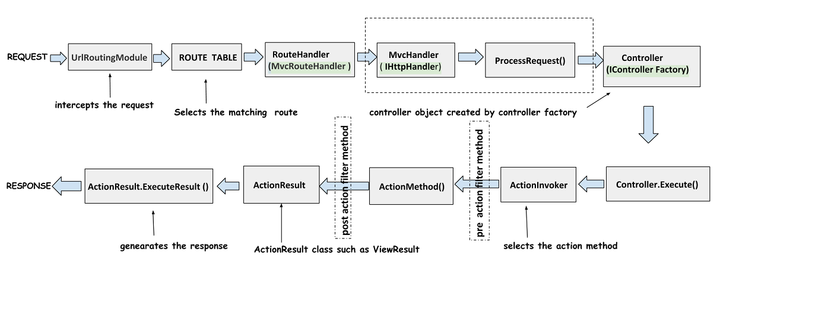
ASP.NET MVC - Life Cycle

Slide 6
1. User make request
2. UrlRoutingModule receive user request and It decides whether the request would be handled by our MVC application or not.
3. RoutHandler match the requested URL with registered routes in route table.
4. MvcHandler initiate Asp.Net pipeline for MVC application. It receive controller instance from controller factory and handle the further processing
5. ControllerFactory create the controller object in ProcessRequest() method of MvcHandler using constructor with no parameters.
6. After creating controller object Execute() method of controllerbase class called.
7. Execute() calls ExecuteCore() abstract method and that retrieve action name from route data.
8. ExecuteCore() calls ActionInvoker's InvokeAction() method
9. ActionInvoker find the action method in controller and invoke it.
10. controller action method generate the action result to display on view for client.

Slide 7
UrlRoutingModule
The request is first intercepted by the UrlRoutingModule which is a HTTP Module. This module that decides whether the request would be handled by our MVC application. UrlRoutingModule selects the first matching route.
How does the UrlRoutingModule matches the request with the routes in the application?.
If you look into the RegisterRoutes method called from the global.asax you will notice that we add routes to the routes RouteCollection. This method is called from the application_start event handler of the global.asax
It is this RegisterRoutes method which registers all the routes in the application

Slide 8
RouteConfig.RegisterRoutes(RouteTable.Routes);
public static void RegisterRoutes(RouteCollection routes)
{
routes.IgnoreRoute("{resource}.axd/{*pathInfo}");
routes.MapRoute(
name: "Default",
url: "{controller}/{action}/{id}",
defaults: new { controller = "Home", action= "Index", id = UrlParameter.Optional }
);
}

Slide 9
RouteHandler
Whenever a request is received by MVC, it is the job of the routing engine to match the request URL with the registered routes. After finding the matched route, the route handler for the route is being called. Each route can have its own route handler. A route handler is a class that implements IRouteHandler interface.
MvcHandler
This handler is responsible for initiating the ASP.NET pipeline for an MVC application. It receives a Controller instance from the MVC controller factory; this controller handles further processing of the request.
ControllerFactory
The controller is the glue between your View and Logic. The controller object is created by the default controller factory object using the constructor with no parameters.

Slide 10
Controller
So we have seen that the ControllerFactory creates the Controller object in the ProcessRequest() method of the MvcHandler.
As we know a controller contains the action methods. An action method gets called when we request a URL in the browser. Instead of explicitly implementing the IController interface we create our controllers using the Controller class which provides many features for us.
After the controller object is created using the controller factory following happens :
The Execute() method of the controllerbase is called
This Execute() method calls the ExecuteCore() method which is declared abstract and is defined by Controller class.
The Controller class's implementation of the ExecuteCore() method retrieves the action name from the RouteData
ExecuteCore() method calls ActionInvoker's InvokeAction() method.

Slide 11
ActionInvoker
The ActionInvoker class has some of the most important responsibilities of finding the action method in the controller and then invoking the action method.
ActionResult
One of the characteristics of the action method is that instead of returning different data types it always returns the ActionResult type
Below are some of these methods and the type of ActionResult they return
Action Result Class | Helper Method | Return Type
ViewResult | View | web page
JsonResult | Json | Returns a serialized JSON object
RedirectResult | Redirect | Redirects to another action method
ContentResult | Content | Returns a user-defined content type

Slide 12
ASP.NET MVC - Routing
Routing is the process of directing an HTTP request to a controller and the functionality of this processing is implemented in System.Web.Routing.
A route is a URL pattern that is mapped to a handler. A handler can be a class that processes the request, such as a controller in an MVC application.
using System.Web.Routing;
namespace MVCFirstApp
{
public class RouteConfig
{
public static void RegisterRoutes(RouteCollection routes)
{
routes.IgnoreRoute("{resource}.axd/{*pathInfo}");
routes.MapRoute(
name: "Default",
url: "{controller}/{action}/{id}",
defaults: new{ controller = "Home", action = "Index", id = UrlParameter.Optional});
}
}
}

Slide 13
Attribute routing
Attribute routing provides you more control over the URIs by defining routes directly on actions and controllers in your ASP.NET MVC. When convention-based routing is complex to support certain URI patterns than this type of routing is used in RESTful APIs
1. Controller Level Attribute routing
[RoutePrefix("MyHome")]
[Route("{action=index}")] //default action
public class MyHomeController : Controller
{
//new route: /MyHome/Index OR Home/Index
public ActionResult Index()
{
return View();
}
}
2. Action Level Attribute routing
[Route("MyHome/{id:int:min(100)}")]
public ActionResult Index(int id)
{
//route: / MyHome/100
return View();
}

Slide 14
Custom Routing
It is possible to develop an MVC application without creating a Custom Route. But sometimes, there is a situation to change the pattern of URL in which it makes sense to create Custom Routes.
using System.Web.Routing;
namespace MVCFirstApp
{
public class RouteConfig
{
public static void RegisterRoutes(RouteCollection routes)
{
routes.MapRoute(
name: “MyHomeCustomRoute",
url: “MyHome/{action}/{id}",
defaults: new{ controller = "Home", action = "Index", id = UrlParameter.Optional});
}
}
}
Url in browser will be shown as below for above custom routing:
http://localhost:8080/MyHome/Index/1

Slide 15
Route Constraints: If we want to restrict incoming request with some numeric ,date, HTTP method type constraint then we can define route as below. Regular Expression Route Constraint: routes.MapRoute( "Blog", "Archive/{entrydate}", new { Controller = "Blog", action = "Archive"}, new { entryDate = @"\d{2}-\d{2}-\d{4}"},//Custom route with regular expression ); http://example.com/Archive/Archive/16-02-2017 Http Method Route Constraint: routes.MapRoute( "Blog", "Archive/{entrydate}", new { Controller = "Blog", action = "Archive"}, new {method = HttpMethodConstraint(“Get”)//custom route with HTTP method constraint ); http://example.com/Archive/Archive

Slide 16
Action Selector
There are three types of Action Selector attributes −
ActionName
NonAction
ActionVerbs
[HttpGet]
[ActionName("CurrentTime")]
public string GetCurrentTime(){
return TimeString();
}
[NonAction]
public string TimeString(){
return "Time is " + DateTime.Now.ToString("T");
}
ActionVerbs
Another selector filter that you can apply is the ActionVerbs attributes. So this restricts the indication of a specific action to specific HttpVerbs. You can define two different action methods with the same name but one action method responds to an HTTP Get request and another action method responds to an HTTP Post request.

Slide 17
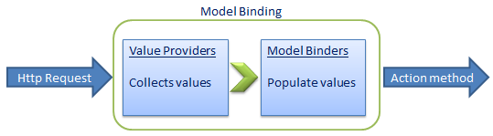
ASP.NET MVC - Model Binding
ASP.NET MVC model binding allows you to map HTTP request data with a model. It is the process of creating .NET objects using the data sent by the browser in an HTTP request.
Value Provider: Value Provider is like parsed source of dictionary that help model binder to get appropriate value for its model. Value providers are responsible for collecting the values that are part of the current request
Model Binder: Model binders are responsible for populating values from value providers and building up object in the action method parameters.

Slide 18
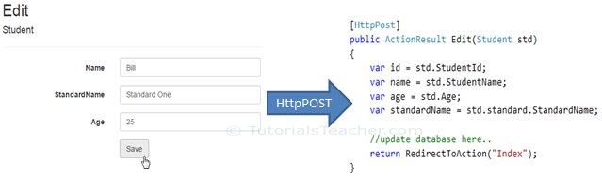
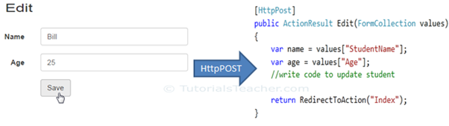
Model Binding with complex type parameter
Model Binding with FormCollection

Slide 19
ViewBag, ViewData and TempData
ASP.NET MVC offers us three options - ViewData, ViewBag and TempData for passing data from controller to view and in next request. ViewData and ViewBag are almost similar and TempData performs additional responsibility. Let's discuss or get key points on those three objects:
ViewBag:
ViewBag transfers data from the controller to the view, ideally temporary data which in not included in a model.
ViewBag is a dynamic property that takes advantage of the new dynamic features in C# 4.0
You can assign any number of propertes and values to ViewBag
The ViewBag's life only lasts during the current http request. ViewBag values will be null if redirection occurs.
ViewBag is actually a wrapper around ViewData.
ViewData:
ViewData transfers data from the Controller to View, not vice-versa.
ViewData is derived from ViewDataDictionary which is a dictionary type.
ViewData's life only lasts during current http request. ViewData values will be cleared if redirection occurs.
ViewData value must be type cast before use.
ViewBag internally inserts data into ViewData dictionary. So the key of ViewData and property of ViewBag must NOT match.
Difference between ViewBag & ViewData:
ViewData is a dictionary of objects that is derived from ViewDataDictionary class and is accessible using strings as keys.
ViewBag is a dynamic property that takes advantage of the new dynamic features in C# 4.0.
ViewData requires typecasting for complex data type and check for null values to avoid error.
ViewBag doesn’t require typecasting for complex data type.

Slide 20
public ActionResult Index()
{
IList<Student> studentList = new List<Student>();
studentList.Add(new Student(){ StudentName = "Bill" });
studentList.Add(new Student(){ StudentName = "Steve" });
studentList.Add(new Student(){ StudentName = "Ram" });
ViewBag.Id = 1;
ViewBag.Name = “Sachin”;
ViewData[“StudentList”] = studentList;
ViewData.Add("Id", 1); // throw runtime exception as it already has "Id" key
return View();
}
//code in view
<div>
@ViewBag.Id
@ViewBag.Name
@foreach (var std in ViewData[“StudentList"] as IList<Student>)
{
@std.StudentName
}
</div>

Slide 21
TempData:
TempData is defined as property in ControllerBase class. It is a type of TempDataDictionary class. Values stored in TempData require typecasting to datatype in View. The values in TempData are accessible using a key. It is similar to ViewData but the difference is that it allow us to send and receive the data from one controller to another controller and from one action to another action. It is possible because it internally uses session variables.
Add value in temp data: TempData["ID"] = 101;
Read temp data: string strID = TempData["ID"].ToString();
Persist after normal read: TempData.Keep(“ID");
Read and persist: string strID = TempData.Peek("MyData").ToString();

Slide 22
Tuple:
A Tuple object is an immutable, fixed-size and ordered sequence object. It is a data structure that has a specific number and sequence of elements. The .NET framework supports tuples up to seven elements. It used to pass multiple models data from controller to view. you should use Tuple only when you do not want to create ViewModel.
public ActionResult IndexTuple()
{
var tupleModel = new Tuple<List<Teacher>, List<Student>>(GetTeachers(), GetStudents());
return View(tupleModel);
}
//Code In View
@model Tuple <List<Teacher>, List <Student>>
@foreach (Teacher teacher in Model.Item1)
{
<tr>
<td>@teacher.TeacherId</td>
<td>@teacher.Name</td>
</tr>
}
@foreach (Student student in Model.Item2)
{
<tr>
<td>@student.StudentId</td>
<td>@student.Code</td>
</tr>
}

Slide 23
Session State Handling in MVC
State management is very important and useful concept in Web application and also its equally very important that resources can not be allocated unnecessarily. In ASP.NET MVC we can manage the session controller specific which helps to disable the session when you don't require IT for particular controller and due to this we can improve the performance of an application by freeing resources not needed to be allocated.
What is SessionState Session State is the attribute of controller class which is used to control or manage the default session behavior. To use session state attribute we need to use System.Web.SessionState namespace. The following are the behavior of the Session State attribute
Default : The default behavior of the session state checks for the session when user request comes to the controller.
Disabled: When SessionState behavior set to disable then it will not check the session when user request comes to the controller and it disabled the session for entire controller and their views .
Required: When the behavior is set to required then every request check for the session and it enabled the session for particular controller. This behavior is used when you want session for every user request.
ReadOnly:When Session state behavior set to ReadOnly then session state can not be modified and updated. This behavior useful to make sure the session state will not be modified.
[SessionState(SessionStateBehavior.Default)]
public class HomeController : Controller
{ //Action methods
}

Slide 24
Thank You

